Slide 1
Pokémon Royale
Daniel Burris
Jairo Arreola
John Mullen
Zachary Johnson

Slide 2

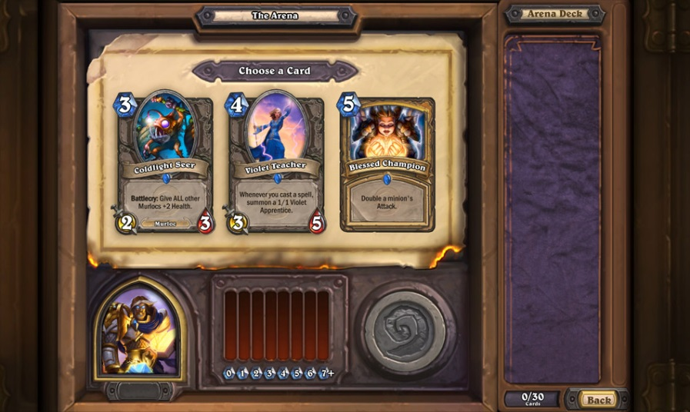
Concept
Similar to Hearthstone Arena, but with Pokémon instead.

Slide 3
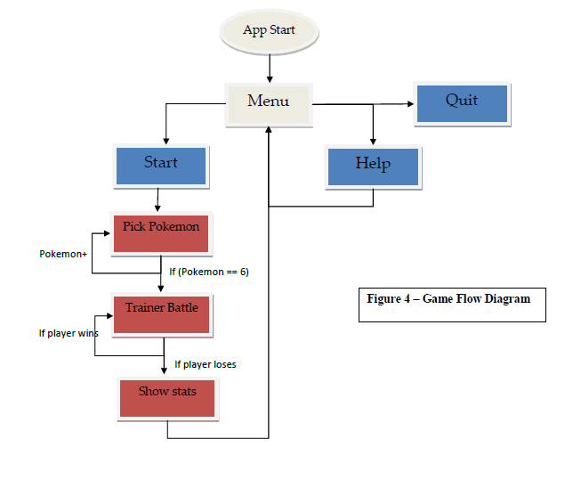
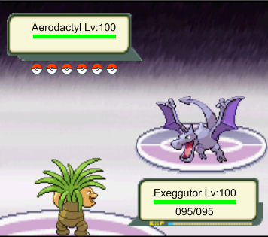
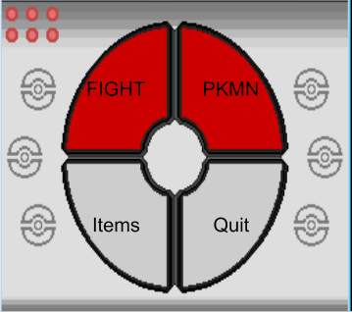
Game Flow

Slide 4
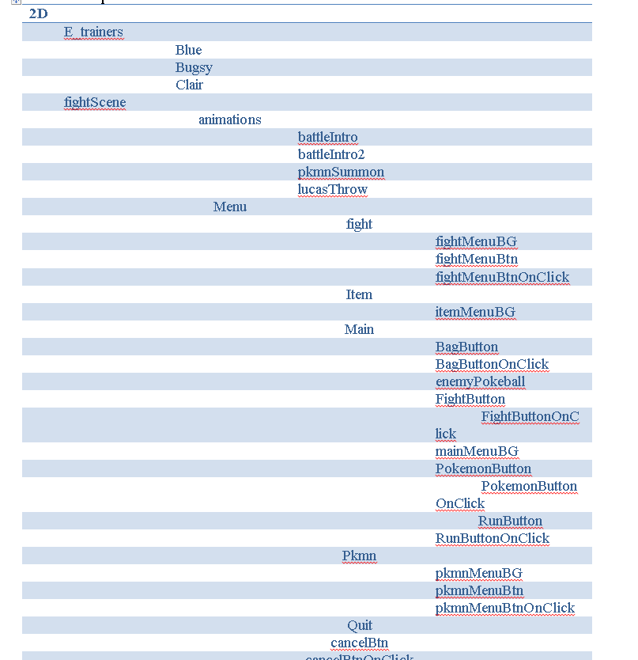
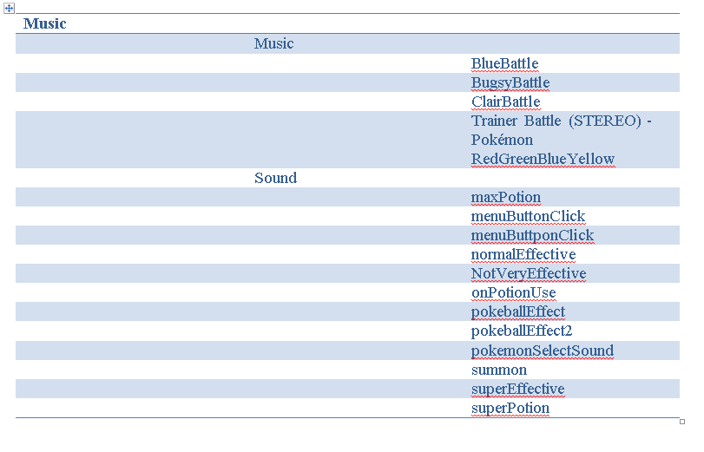
Tech
http://www.pokestadium.com/tools/sprites

Slide 5

Lets get to the demo!

